Slide 1

Important note for teachers
If you want to use the on-screen profile then you must copy the 01_Staying_Safe_InstaSnap_Profile.pps PowerPoint Slide Show into a shared area your students can easily access.

Slide 2
Becoming a digital citizen
Unit: Staying safe and smart online

Slide 3
Objective
I can identify behaviours of a responsible digital citizen.

Slide 4
Keywords
Every time you post, like, or share something online, you leave a digital footprint which is a record of your online activity.
Showing empathy online means considering how your words and actions might affect someone else’s feelings.
Protecting your privacy online means keeping personal information, such as your address or passwords, safe from others.

Slide 5
What do you already know?
The internet is a space where people can communicate, share information and learn new things.
What you post online can be seen by others, even if you delete it.
Bullying can happen both in person and online and it’s important to treat others with kindness.

Slide 6
Steps to success
Digital footprint
Personal privacy

Slide 7
Digital footprint
Work in pairs and discuss the following scenario.
You see a classmate sharing a photo of another student without their permission. Some people in the comments are making fun of the photo.
What would you do?

Slide 8
Digital footprint
Work in pairs and discuss the following scenario.
Your friend receives a private message from someone they don’t know asking for personal information like their phone number or address. They’re not sure if it’s safe to reply.
How would you advise them?

Slide 9
Digital footprint
Work in pairs and discuss the following scenario.
You notice that a popular social media account you follow has posted some information that seems shocking but you’re not sure if it’s true. Your friend believes it straight away and shares it.
What should you do?

Slide 10

Digital footprint
A digital footprint is a record of everything you do online.
It includes the websites you visit, the things you post, the photos you share and the things you like or comment on.

Slide 11
Digital footprint
There are two types of digital footprint:
Active footprint
Passive footprint
What do you think the difference is between the two types of digital footprint?

Slide 12
Digital footprint
Active footprint
Passive footprint
This is created when you deliberately share information online, such as posting on social media, leaving a review, or sending an email.
This is created without you realising it, such as when websites track your browsing habits or collect data about you through cookies.

Slide 13
Digital footprint
Why do you think being aware of your digital footprint matters?
Your digital footprint can affect your reputation both now and in the future.
It can be seen by others including friends, family, teachers and even future employers.
Once something is online, it can be difficult to remove completely.

Slide 14
Digital footprint
A teenager shared a funny but embarrassing photo of their friend on social media without asking for permission.
Do you think they were right to do this?
No, they were not.
The photo went viral and the friend felt humiliated. This damaged their friendship and the friend asked the school to intervene. The teenager learned that even harmless posts can have unintended consequences.

Slide 15
Digital footprint
A student posted rude comments on a public forum about a teacher.
Do you think they were right to do this?
No, they were not.
Years later, when applying for a job, the employer found these comments during an online background check. The student didn’t get the job because the employer questioned their professionalism.

Slide 16
Digital footprint
A person shared personal information on their social media profile, including their home address and holiday plans.
Do you think they were right to do this?
No, they were not.
While they were on holiday, their house was broken into as the burglars knew it would be empty.

Slide 17
Digital footprint
Negative digital footprints happen when you post or share things that could harm your reputation or hurt others.
Examples include:
Posting hurtful or mean comments about someone.
Sharing inappropriate photos or videos.
Spreading false information or rumours online.

Slide 18

Digital footprints
Your digital footprint doesn’t just have to be negative. It can also be positive. Positive digital footprints are created when you share things that reflect well on you and show your best qualities.
Can you think of anything that would create a positive digital footprint?

Slide 19
Digital footprint
Examples can include:
Sharing achievements, such as winning a competition or completing a project.
Posting kind or supportive comments on someone’s post.
Creating helpful or educational content, like a tutorial or an inspiring story.

Slide 20
1: Digital footprint
Here is a list of actions related to online behaviour. For each action, decide whether it creates a positive or negative digital footprint and tick the appropriate column.
Action | Positive | Negative
Writing a supportive comment on someone’s blog post.
Sharing a funny meme that includes someone’s personal photo without their permission.
Complaining about a teacher or classmate publicly on social media.
Posting a video tutorial you created to help others with homework.
Using someone else’s artwork in your own post without crediting them.
Reporting an inappropriate or harmful post to a website administrator.
Sharing your gaming username and password with a friend.
Posting an inspiring story about overcoming a challenge.

Slide 21
1: Digital footprint ANSWERS
Action | Positive | Negative
Writing a supportive comment on someone’s blog post. | ✓
Sharing a funny meme that includes someone’s personal photo without their permission. |  | ✓
Complaining about a teacher or classmate publicly on social media. |  | ✓
Posting a video tutorial you created to help others with homework. | ✓
Using someone else’s artwork in your own post without crediting them. |  | ✓
Reporting an inappropriate or harmful post to a website administrator. | ✓
Sharing your gaming username and password with a friend. |  | ✓
Posting an inspiring story about overcoming a challenge. | ✓

Slide 22
Steps to success
Digital footprint
Personal privacy

Slide 23
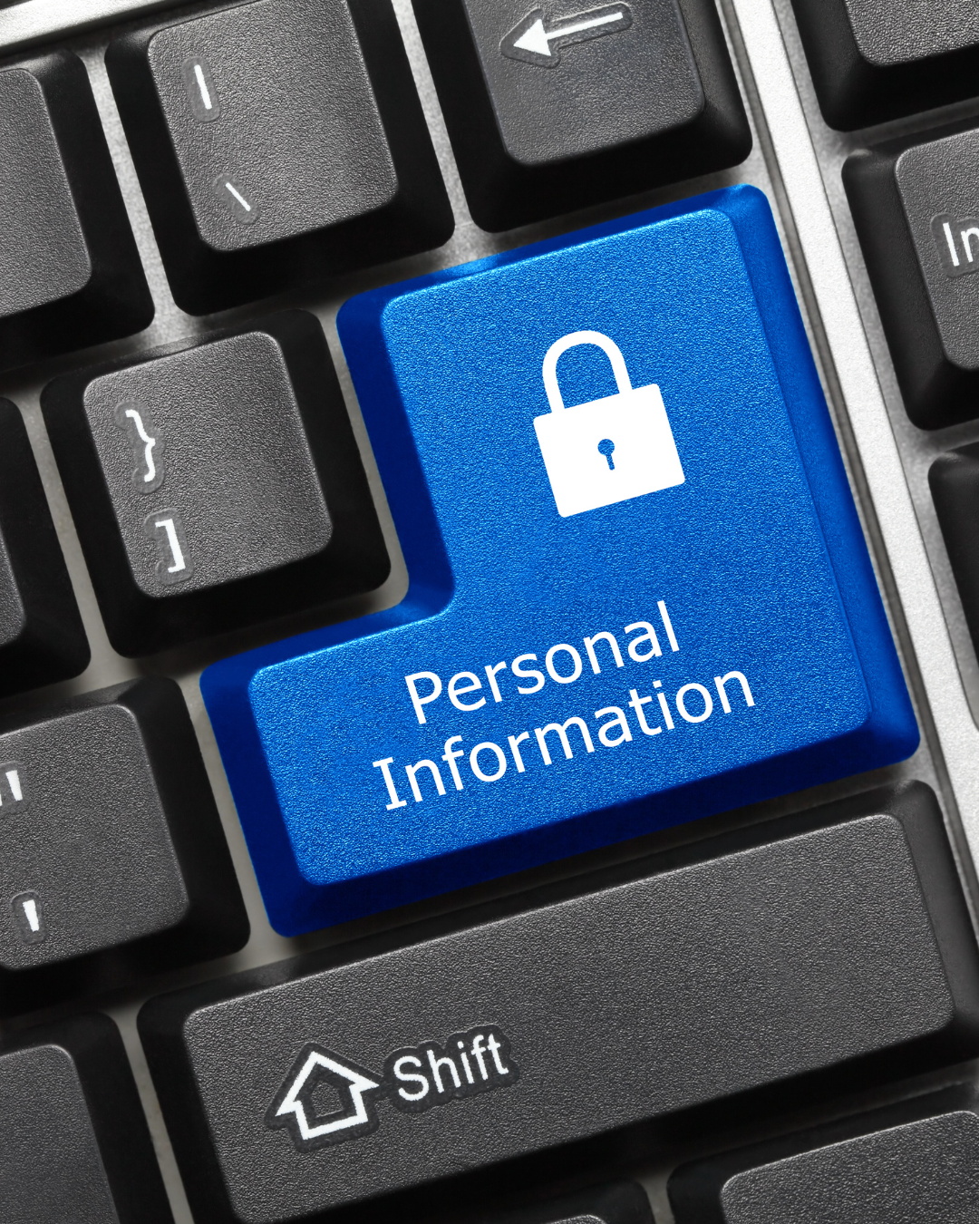
Personal privacy
Personal information is any detail that can identify you or give others access to your private life. Protecting your privacy is important to keep this information safe.
Examples of personal information include:
Your full name.
Your address or phone number.
Your passwords.
Photos or videos of you that give hints about other personal information (e.g. school logo).
Bank details or other sensitive information.

Slide 24
Personal privacy
Why is protecting personal information important?
Protecting personal information keeps you safe and stops people from stealing your data or finding out too much about you.
Safety: Sharing personal details can make you a target for scams or online predators.
Privacy: Your information could be used without your permission, such as being shared publicly or sold.
Control: Once it’s online, it’s hard to remove and it could affect your future (e.g., job opportunities).

Slide 25
Personal privacy
Work in pairs and take a look at the social media account for @CoolKid2025.
Read their profile and each of the three posts to find out more.
What can you find out about them?

Slide 26
Personal privacy ANSWERS
You could have found out:
What they look like (photos)
Their name (Jamie Smith)
The city they live in (London)
Their school (St. Francis School, the logo is on their jumper in their profile image)
The year they are in at school (year 11)
Their gaming ID (jsmith29462)
Their YouTube channel (jsmith_coolkid2025)
The area they live in (around the corner from their school)
Their address (you can go to that area and look for the house in the photo)
Where they are likely to hang out (the park is likely to be near their home)
Their password (note in photo); they may use the same password for all the known user IDs
Their date of birth (you can work out their birthday because of the comments and knowing the year they are at school)
Their house is empty as they are on holiday with their family
Their bank account details (photo)

Slide 27
Personal privacy
Privacy settings are tools on social media platforms that help you control:
Who can see your posts and photos.
Who can send you messages or friend requests.
What information about you is visible to others.

Slide 28

Personal privacy
You can alter how social media platforms display your data and the privacy settings also allow you to change how others can interact with you.
Let’s look at some of the things you can change.

Slide 29
Personal privacy
Limit who can see your posts:
Set your profile to private so only approved friends can view your content.
Control tagging:
Approve tags before they appear on your profile.

Slide 30
Personal privacy
Review your profile information:
Hide sensitive details like your birthday, school or location.
Block and report:
Use block and report features to stop unwanted interactions.

Slide 31
Personal privacy
You need to regularly check and update your privacy settings to stay in control of your online presence.
This needs to be done on every social media platform or chat forum you use.

Slide 32
Personal privacy
What could happen if someone shares too much personal information online?
If someone shares too much personal information online, strangers could find out where they live or go to school, and they might get scammed or hacked. It could also make it easier for someone to pretend to be them and commit criminal acts.

Slide 33
© 2025 Nichola Wilkin Ltd
https://www.nicholawilkin.com/terms

